Slide 1
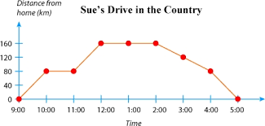
Bell Work
Describe the following:

Slide 2
Math analysis
Day 4

Slide 3
Objective
Check out computers
Begin to work with The Grid
Save, Upload, Download, and Resave
Create Patterns, Pixel Art and Presentation

Slide 4
The Grid
Patterns [ ]
Pixel Art [ ]
Presentation [ ]

Slide 5
Pattern
Set your grid size to 12
Create a pattern that fills all of the squares
(partial patterns on the edges are to be expected)
Save your grid to the OneDrive
Share your pattern with a friend
Open your friends pattern
Set the grid size to 20 and finish your partners pattern
Save the pattern and send it back

Slide 6
Pixel Art
Create your Own Design/Image/Name or locate a simple Pixel Art on Google that you can replicate using The Grid
Make notes about your thought process, as you work through the pixel art.
This will be graded by the organization of the design, the creativity, and presentation that follow

Slide 7
Presentation
Prepare a 3-5 minute presentation of the Pixel Art you created, and what thought process went into creating it.
Focus on explaining what process used, where you excelled, where you struggled, and overall explanation of why you created what you did

Slide 8
Exit Ticket:
Post your saved Pixel Art to the Teams message board

